Slide 1

GPA WIZARD An Admission management system for Humber college

Slide 2
Team 5
CHARMY PATEL
PRAVINA PRAJAPATI
SAI CHARAN VARADHI
SIDDHARTH PATEL AKULA
SYED MOBASHIRA SULTANA

Slide 3
AGENDA
OBJECTIVE
SYSTEM REQUIREMENTS
OUR APPROACH
SYSTEM DESIGN (using IPO methodology)
REPORTS

Slide 4
Our system, which was created for the Humber college admission office, asks the user to enter the names and high school course grades of each newly admitted student. The program will then determine each student’s GPA and utilize that information to allocate them to different schools(3 schools currently) depending on their GPA. In addition, the system provides four reports based on the final total of accepted students.
OBJECTIVE

Slide 5
SYSTEM REQUIREMENTS
4
Reports
3 attempts
3 attempts
3 attempts
LOGIN USING PASSWORD
NUMBER OF STUDENTS
GENERATE GPA
By satisfying certain rules
Criteria = Between 1 to 50 students
Assign schools based on GPA

Slide 6
OUR APPROACH
Our team first ensured a comprehensive understanding of the project's requirements.
We broke down the goals into smaller, more manageable steps and carefully analyzed the logic required to accomplish each one.
We proceeded to code the program according to the defined steps.
We tested it thoroughly with a variety of inputs and checked for different outputs.
We made the system available for admission department of Humber College.

Slide 7
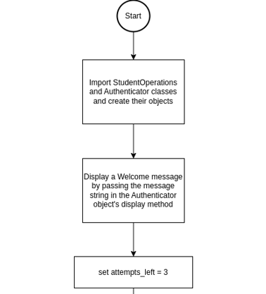
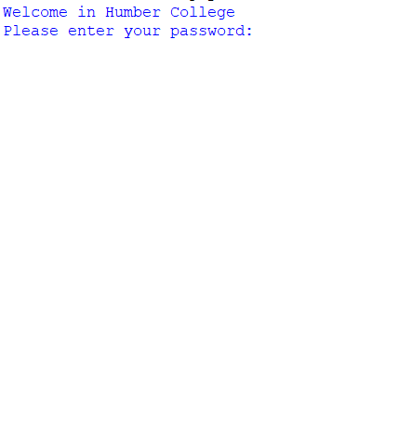
System Design (using IPO methodology)
Welcome message in System
Output:

Slide 8
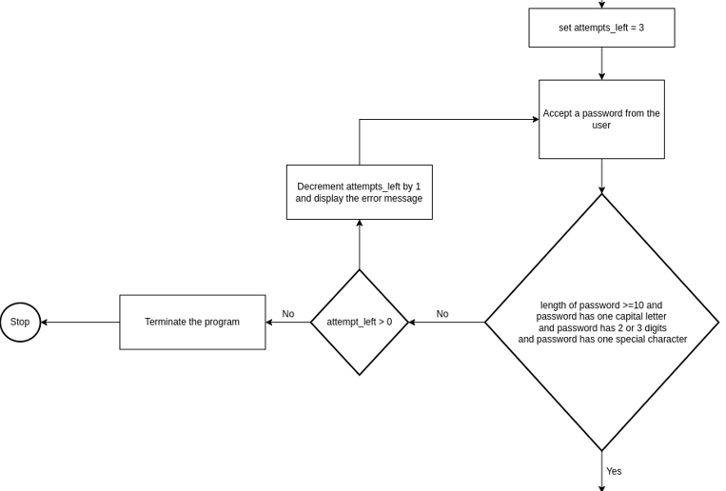
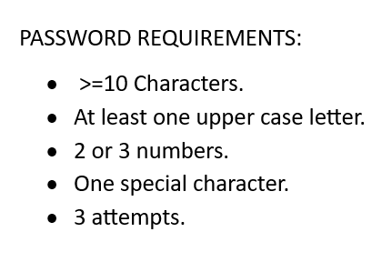
password
Password accepted

Slide 9
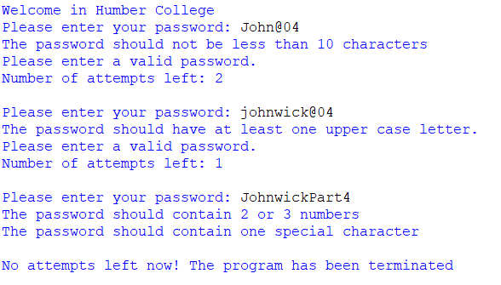
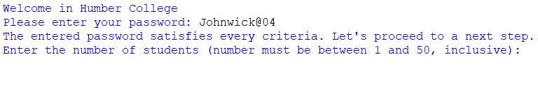
TEST CASES OF PASSWORD
WRONG PASSWORD INPUT FOR CHARACTER LENGTH:
WRONG PASSWORD INPUT FOR UPPER CASE LETTER:
WRONG PASSWORD INPUT FOR DIGITS & SPECIAL CHARACTER:
CORRECT PASSWORD INPUT:

Slide 10
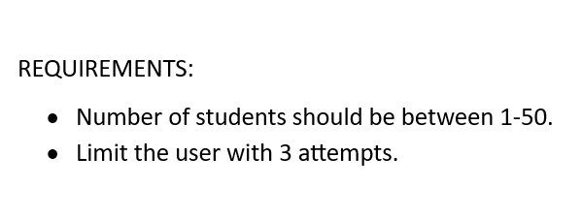
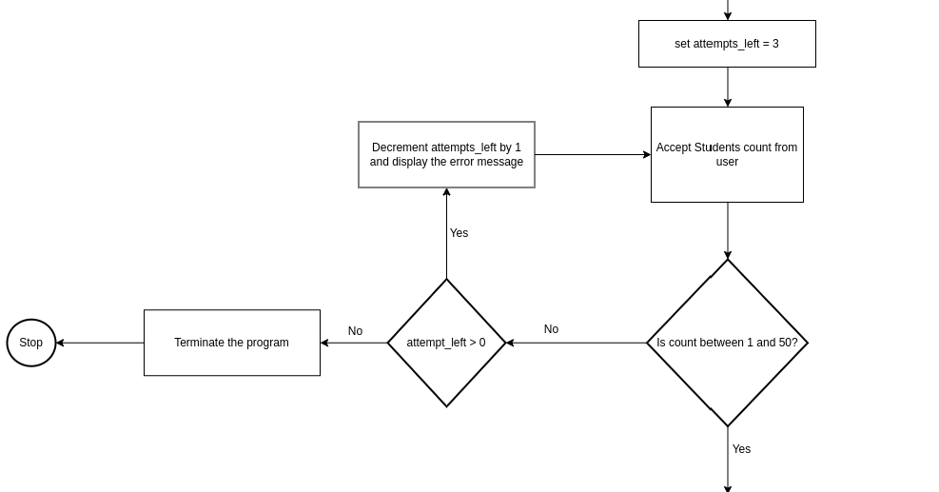
NUMBER OF STUDENTS
Password accepted, proceeds ahead
STUDENT COUNT ACCEPTED

Slide 11
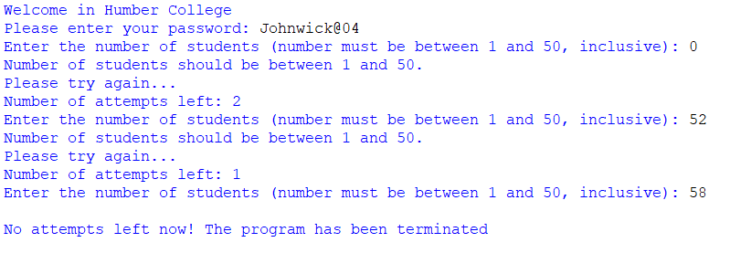
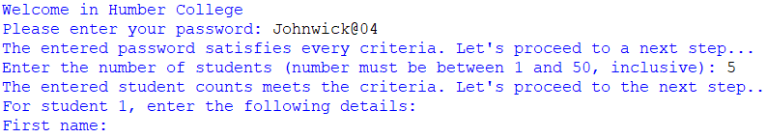
TEST CASES FOR NUMBER OF STUDENTS
WRONG INPUT FOR THE NUMBER OF STUDENTS:
CORRECT INPUT FOR NUMBER OF STUDENTS:

Slide 12
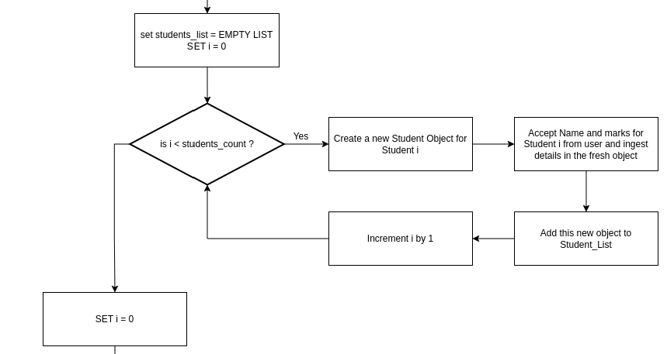
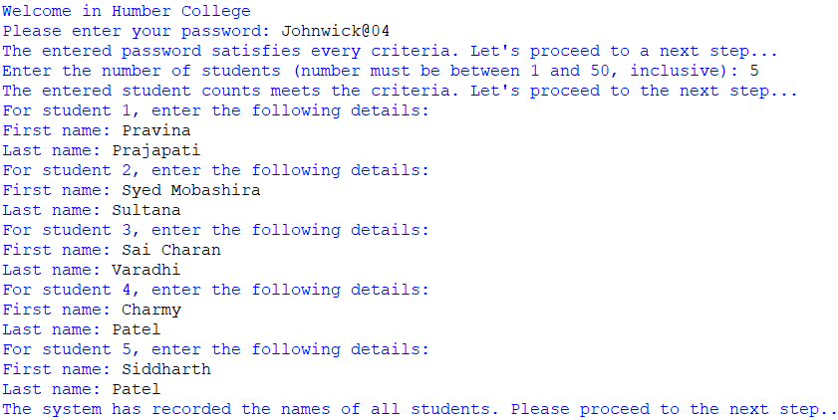
RECORDING NAMES OF STUDENTS
TEST CASES FOR RECORDING NAMES:
Accept Name for Student i from user and ingest details in the fresh object
PROCEED AHEAD

Slide 13
RECORDING Marks OF STUDENTS
Accept marks for Student i from user and ingest details in the fresh object
PROCEED AHEAD

Slide 14
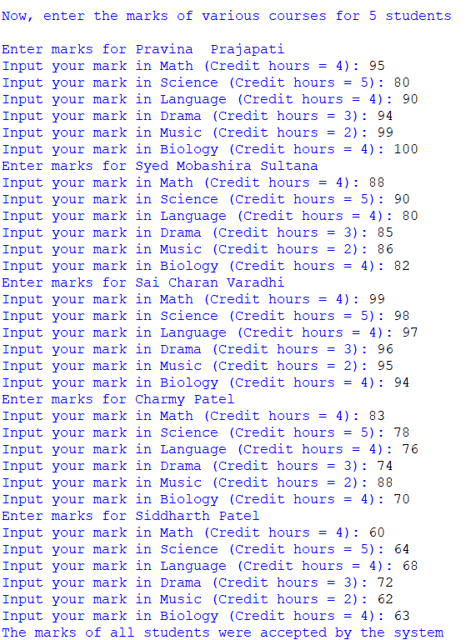
TEST CASES FOR RECORDING MARKS

Slide 15
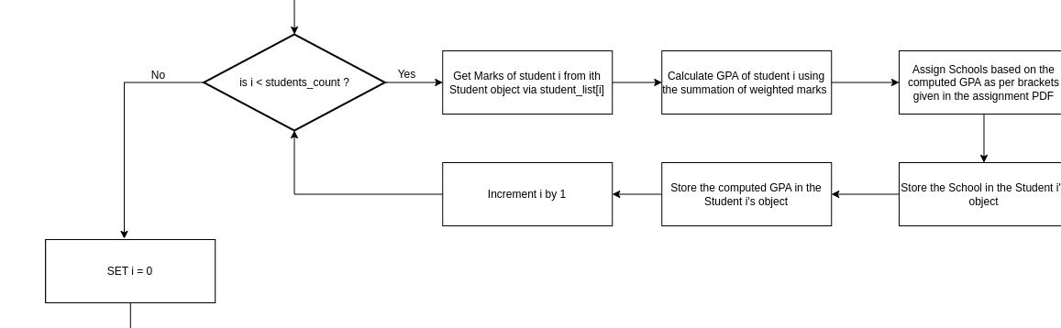
CALCULATING GPA
PROCEED AHEAD

Slide 16
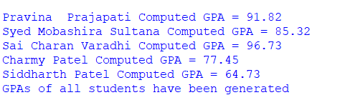
CALCULATING GPA
After inputting marks, the GPA’s of all students will be generated.
Formula:
GPA= ∑ (Mark * Credit hours)/total credit hours
STUDENT WISE GPA OUTPUT:

Slide 17
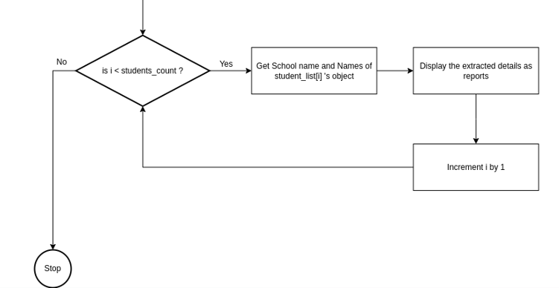
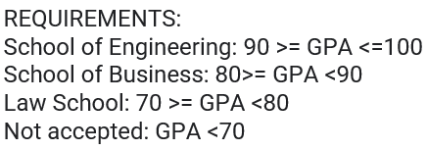
ASSIGNING SCHOOLS AND GENERATING REPORTS
PROGRAM FINISHED

Slide 18
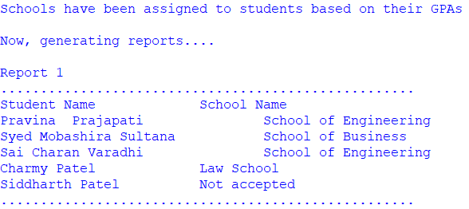
GENERATING REPORTS
REPORT 1 : Assigning schools

Slide 19
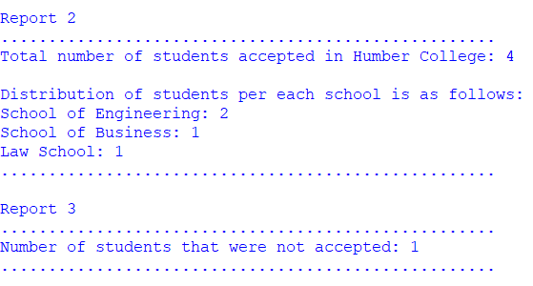
GENERATING REPORTS
REPORT 2 & 3 : Total number of students accepted/not accepted in Humber college

Slide 20
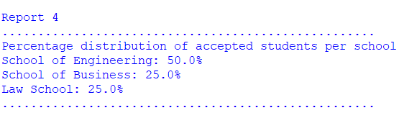
GENERATING REPORTS
REPORT 4 : Percentage distribution of accepted students per school

Slide 21
THANK YOU

